Slide 1
Theory-Driven Text Analysis for Psychologists: A Hands-On Workshop
Instructors: Mohammad Atari & Ali Omrani

Slide 3
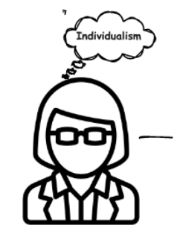
Top Down
Bottom Up

Slide 4
Top Down
Bottom Up

Slide 5
What we won’t be talking about today!
Everything we are going to talk about is limited to psychological text analysis. That is, we won’t talk about NLP research that cannot be (or was not designed to) help us learn about human emotions, cognition, attitudes, and behaviors across time, space, individuals, and contexts.
Rule 1: No word-clouds!
Rule 2: Using the word “ChatGPT” is strictly PROHIBITED!
kidding… happy to chat about them.

Slide 6
Psychological Measurement using Text
Majority of text-analysis research in psychology has relied on top-down analyses
Dictionary-based methods (General Inquirer, Stone, et al., 1966; LIWC, Pennebaker, et al., 2001)
Language linked to personality, clinical diagnosis and treatment, morality, cultural epistemological orientations, etc.
Example researcher-created dictionary for happiness: happy, happiness, cheerful, laugh, smile, etc.
Advantage:
Freedom to create sets of words that can target some theoretical construct
Empirically validated (e.g., Graham, et al., 2009 )

Slide 7
Psychological Measurement using Text
I am happy when i see my cat. (⅛ = 0.125 on happiness)
I am on cloud nine when I see my cat. (0)
I am soooo happyyyy when I see my cat. (0)
Psychologically, the person is expressing the same positive affect in all three sentences.
Word-counting methods fail to capture this sentiment in the second and third sentences.

Slide 8
Psychological Measurement using Text
Challenges for dictionary-based approaches:
Difficult to include all the words which may be relevant to a psychological category
Blind to context: “I have never been happy in my life” vs. “I have never been this happy my life”
Some concepts are not easily represented using single words
Polysemy (e.g., bank: bank of a river; financial institution)
Dictionaries may not capture all sociolects of words (e.g., African American English)
Language is dynamic and generative even a theoretically universal dictionary would not remain so for long
This might undermine replicability of results in the long run
While some words might be clearly indicative of a given pattern or opinion, others are only marginally so (“reasoning” is clearly about deliberative cognitive processes, but “probably” is only marginally indicating of deliberation).

Slide 9
Going beyond words-as-atomic-units
What if we could capture the meaning of a psychological category, instead of coming up with a bunch of words?
Distributed Representations do exactly that!
Latent Semantic Analysis (LSA) (Deerwester, et al. 1990):
Emerged from psychology on word meaning and language learning (Landauer & Dumais, 1997, Psych Review)
Creates a space where words that occur in the same documents are pulled closer together in the resulting space.
The recent dominance of Distributed Representations is largely attributed to the success and widespread adoption of neural networks

Slide 10
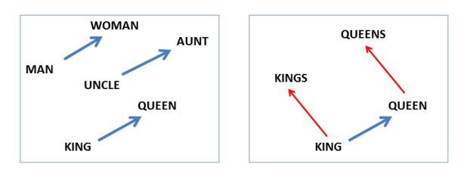
Word Embeddings
“You shall know a word by the company it keeps” (Firth, J. R. 1957:11)
Represents meaning of words as points in a high-dimensional vector space
V[King] ~ V[Man] = V[Queen] ~ V[Woman]
Mikolov, et al. 2013

Slide 11
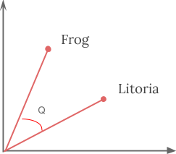
Word Embeddings
Word embeddings give us the ability to compute similarity between two words based on their vector representation (a distance metric).
An early test was to evaluate the reasonability of the nearest neighbors of a particular term or phrase (Jones & Mewhort, 2007; Mikolov, et al., 2013).
These neighbors tended to be highly meaningful: e.g., nearest terms to "frog”: "frogs", "toad", "litoria", "leptodactylidae", "rana" (Pennington et al., 2014)

Slide 12
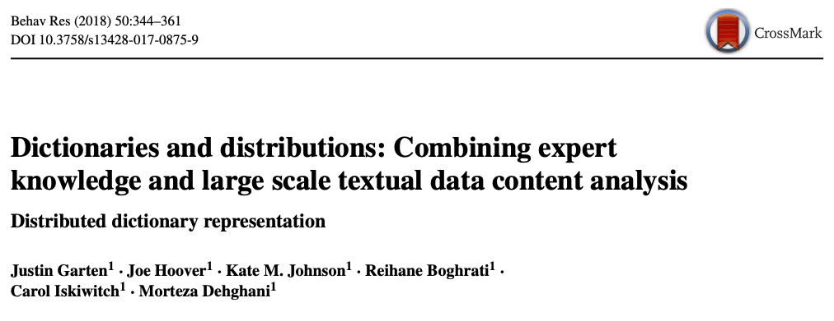
Distributed Dictionary Representation (DDR)

Slide 13
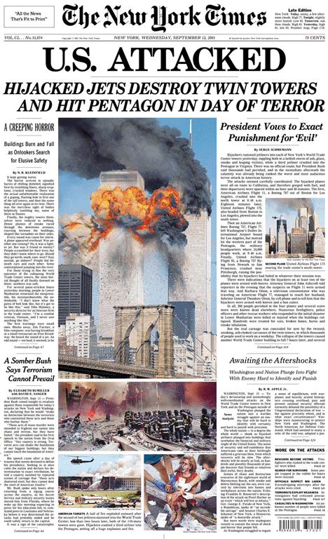
Distributed Dictionary Representation (DDR)
I want to measure “feelings of fear” in text…
terror
fear
horror
scared
0.85

Slide 14
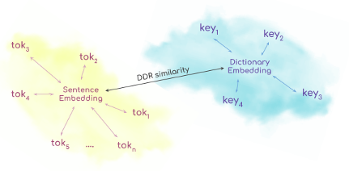
Distributed Dictionary Representation (DDR)
theory
Garten et al., 2017, BRM

Slide 15
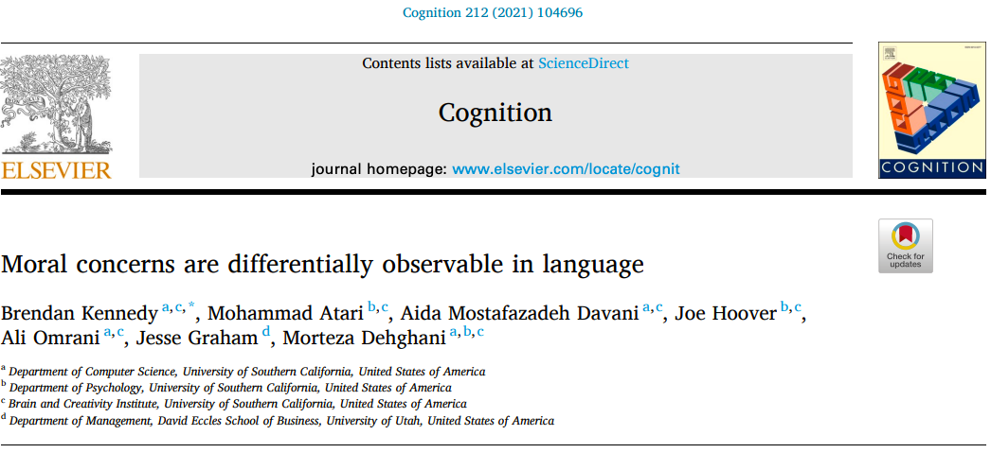
Word-counting vs. DDR

Slide 16
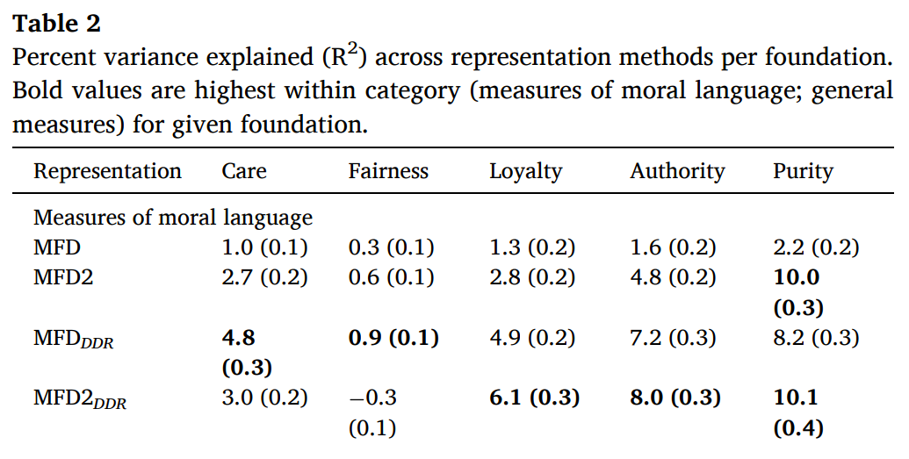
How to measure stuff using language
We used word-counting and DDR
We had two dictionaries: MFD (Graham et al., 2009) and MFD2 (Frimer et al., 2018)
All participants (n = 2,691) donated their Facebook data and completed MFQ (survey)
We report percent of variance explained to predict MFQ scores
Wordcount
DDR

Slide 17
Going beyond Static Embeddings: Contextualized Embeddings
Recently , embeddings have been developed to be dependent on context. For example, bank in “bank of america” and “river bank” will have different embeddings.
So: Sentences can be embedded by combining words’ contextualized embeddings
BERT: it’s a model that was introduced in NLP and outperformed all existing models (e.g., GloVe, Word2Vec) in a variety of language tasks.
BERT (and similar models) give different embeddings for
“Obama loves America” vs. “America loves Obama”
“I have never been happy in my life” vs. “I have never been this happy my life”
“I am happy when i see my cat” vs. “I am on cloud nine when I see my cat”
It shows that contextualized embeddings (sentence embeddings) substantially capture more information

Slide 18
Break!!

Slide 19
Going beyond Static Embeddings: Contextualized Embeddings
Recently , embeddings have been developed to be dependent on context. For example, bank in “bank of america” and “river bank” will have different embeddings.
So: Sentences can be embedded by combining words’ contextualized embeddings
BERT: it’s a model that was introduced in NLP and outperformed all existing models (e.g., GloVe, Word2Vec) in a variety of language tasks.
BERT (and similar models) give different embeddings for
“Obama loves America” vs. “America loves Obama”
“I have never been happy in my life” vs. “I have never been this happy my life”
BERT (and similar models) give very similar embeddings for
“I am happy when i see my cat” vs. “I am on cloud nine when I see my cat”
It shows that contextualized embeddings (sentence embeddings) substantially capture more information

Slide 20
Going beyond Static Embeddings: Contextualized Embeddings

Slide 21
Introducing Contextualized Construct Representation (CCR)

Slide 22
Introducing Contextualized Construct Representation (CCR)
Assumption 1. We know that word lists have problems.
Assumption 2. Psychologists are not good at developing word lists (and even DDR needs “seed words” to function)
Assumption 3. Psychologists are good at self-report methodology (surveys).
CCR: If the meaning of psychological constructs is well-preserved in validated surveys (i.e., sentences or “items”), we should be able to use contextualized embeddings of survey items to measure relevant psychological categories in text.

Slide 23
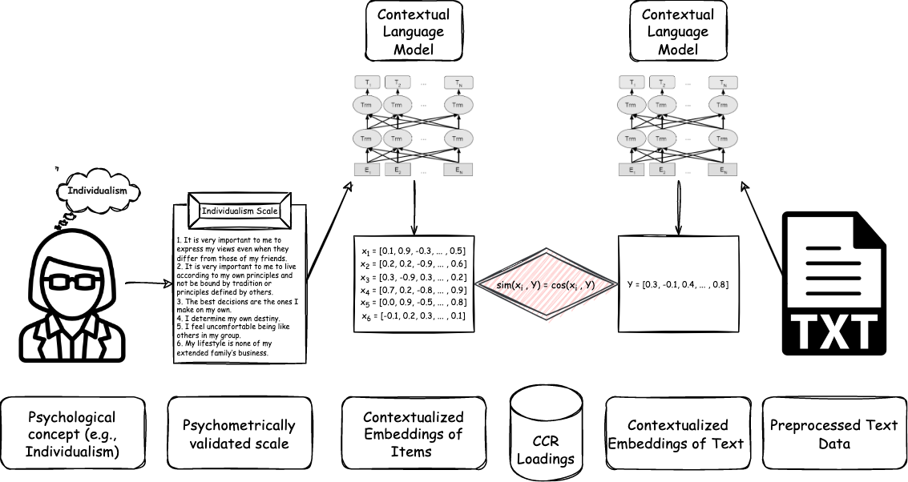
Introducing Contextualized Construct Representation (CCR)

Slide 24
Introducing Contextualized Construct Representation (CCR)

Slide 25
Introducing Contextualized Construct Representation (CCR)

Slide 26
Introducing Contextualized Construct Representation (CCR)

Slide 27
Introducing Contextualized Construct Representation (CCR)

Slide 28
Introducing Contextualized Construct Representation (CCR)

Slide 29
Introducing Contextualized Construct Representation (CCR)

Slide 30
Introducing Contextualized Construct Representation (CCR)

Slide 31
Introducing Contextualized Construct Representation (CCR)

Slide 32
Introducing Contextualized Construct Representation (CCR)
[0.4,0.8,0.9,.......]

Slide 33
Introducing Contextualized Construct Representation (CCR)
Sim
Sim
Sim
[0.4,0.8,0.9,.......]
Sim
Sim
Sim

Slide 34
Introducing Contextualized Construct Representation (CCR)

Slide 35
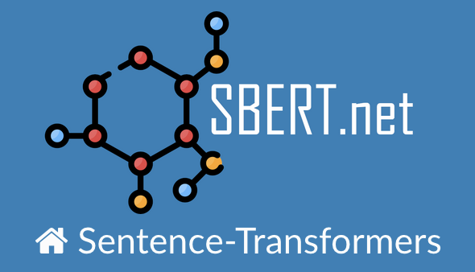
Not all embeddings are the same!
BERT embeddings don’t do well for Semantic Textual Similarity (STS) tasks
We need to modify BERT embeddings to capture semantic similarity!

Slide 36
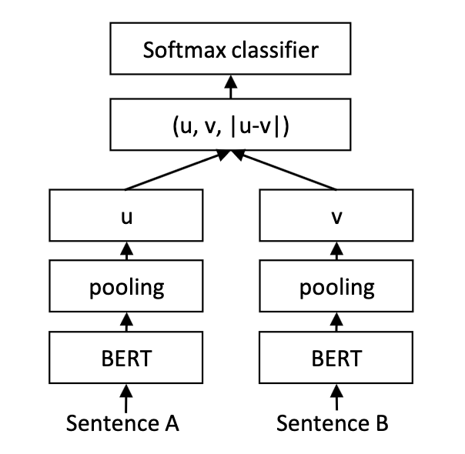
Sentence BERT (S-BERT)
Siamese and triplet network (Schroff et al., 2015)
Pooling Strategy → to get fixed sized embedding
E.g., [CLS] token or mean of all output vectors
Combining Vectors
(u,v) or |u-v| or …
Task to train the model
SNLI
STSb
Task specific head
Vector Combination

Slide 37
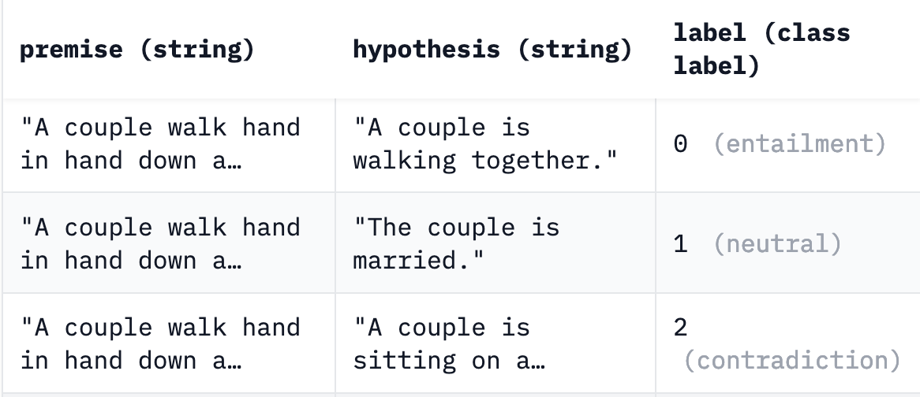
Task SNLI example

Slide 38
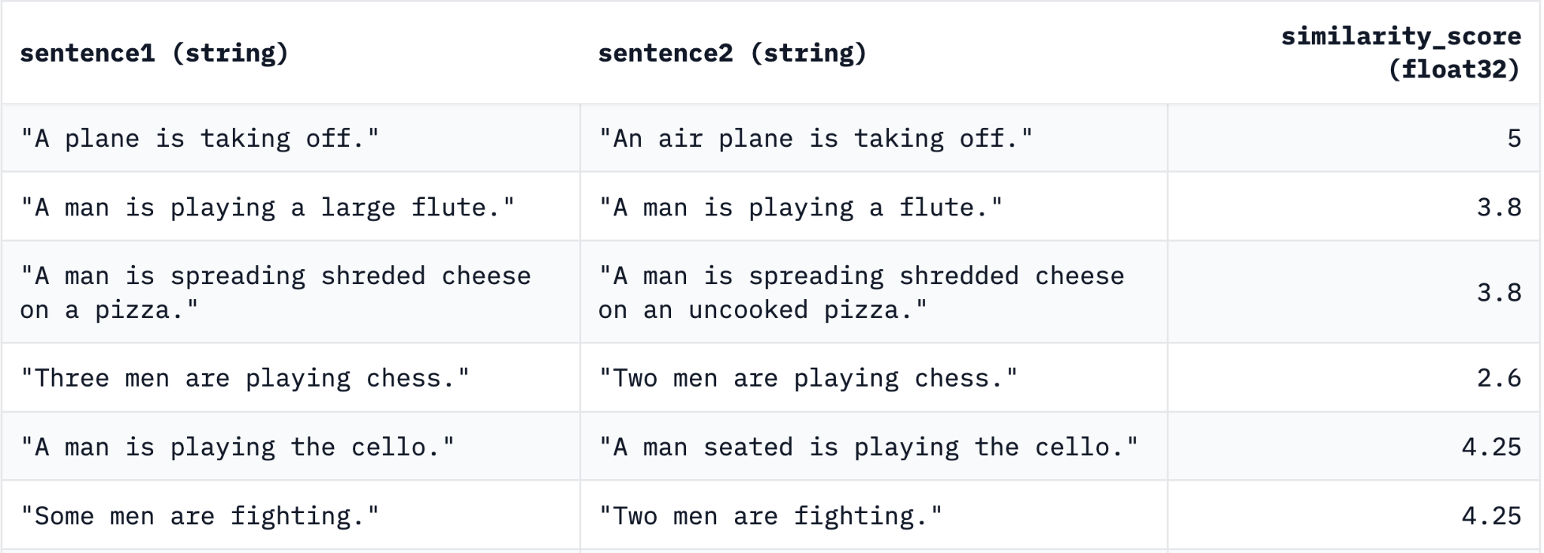
Task - STSb Examples

Slide 39
Sentence BERT (S-BERT)

Slide 40
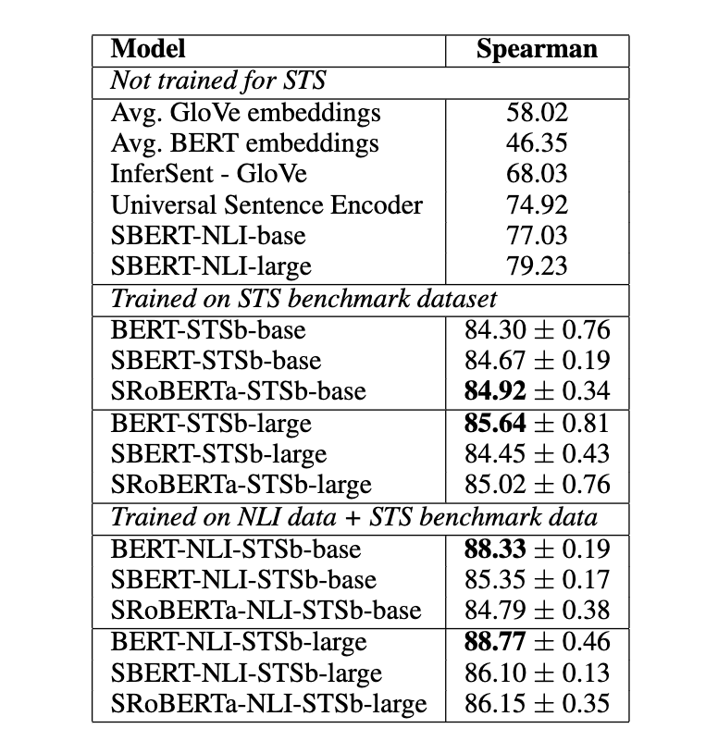
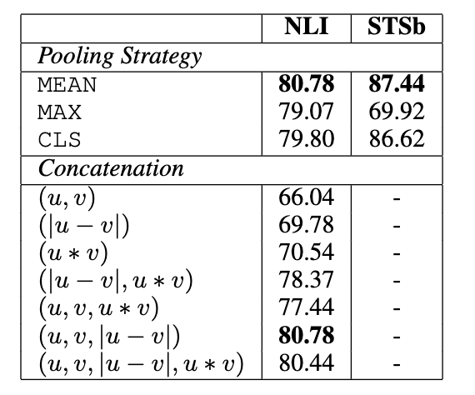
Sentence BERT (S-BERT)

Slide 41
Introducing Contextualized Construct Representation (CCR)

Slide 42
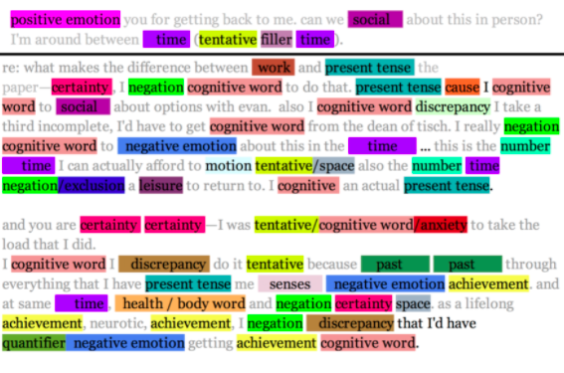
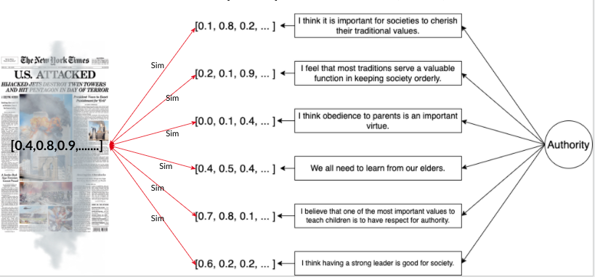
Research
Word Counting (Pennebaker, 2001)
DDR (Garten et al., 2017)
CCR (Atari et al., in prep)
Takes wordlists
Gives ratio of those words to the length of the document
Takes 4 representative words
Gives the similarity between the centroid of those 4 words and the entire document using embeddings
Takes multiple sentences
Gives the similarity between the semantic meaning of the whole sentence and the document

Slide 43
Comparing Word-counting, DDR, and CCR
Recruited 305 adult US participants online (first language: English)
All participants were asked to write two short essays (Boyd et al., 2015)

Slide 44
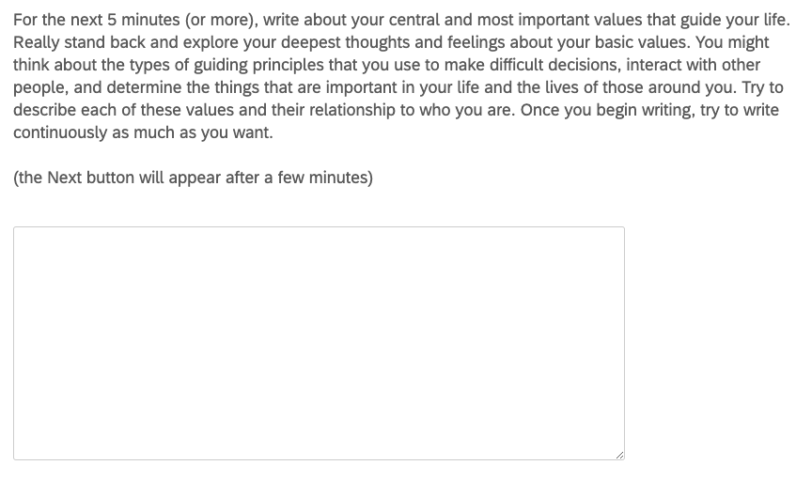
Comparing Word-counting, DDR, and CCR
Recruited 305 adult US participants online (first language: English)
All participants were asked to write two short essays (Boyd et al., 2015)
The “Values Essay”

Slide 45
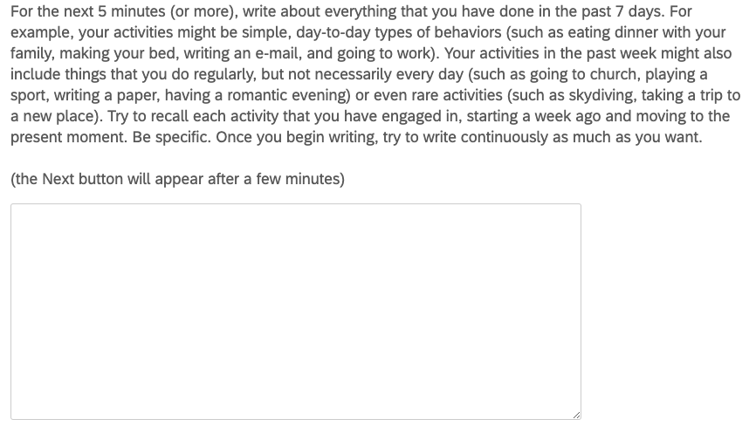
Comparing Word-counting, DDR, and CCR
Recruited 305 adult US participants online (first language: English)
All participants were asked to write two short essays (Boyd et al., 2015)
The “Values Essay”
The “everyday essay”

Slide 46
Comparing Word-counting, DDR, and CCR
Recruited 305 adult US participants online (first language: English)
All participants were asked to write two short essays (Boyd et al., 2015)
The “Values Essay”
The “everyday essay”
Then participants completed validated questionnaires:
Religiosity: religious practice
Moral foundations: care, equality, proportionality, loyalty, authority, purity
Schwartz personal values: Conformity, Tradition, Security, Power, Achievement, Hedonism, Stimulation, Self-Direction, Universalism, and Benevolence
Cultural tightness: the strength of social norms and degree of sanctioning within societies
Individualism: tendency to focus on personal identity and autonomy
Collectivism: social behavior is guided largely by goals that are shared by a collective
Political conservatism: right-wing ideology
Need for cognition: inclination toward effortful, deliberative cognitive activities

Slide 47
Comparing Word-counting, DDR, and CCR
Methods for text processing for the “values essay” and the “everyday essay”:
Preprocessing: drop numbers, make sure words are English, tokenize
Word counting: Prepared word-lists for all variables based on the literature
DDR: GloVe word embeddings (trained on 6 Billion tokens, 300 dimensions)
CCR: transformer-based trained for sentence pairing (similar to BERT)

Slide 48
Values Essay: Cultural and Cognitive Variables
Values Essay: Table of R-squared (%)
Method | Tightness | Individ. | Collect. | Cognition | Religiosity | Conservatism
Count | 0.05% | 1.59% | 0.00% | 0.19% | 12.00% | 2.78%
DDR | 0.06% | 0.03% | 0.00% | 0.81% | 9.43% | 0.33%
CCR | 0.51% | 4.58% | 3.70% | 1.01% | 13.30% | 10.19%

Slide 49
Values Essay: Personal Values
Values Essay: Table of R-squared (%)
Method | SD | PO | UN | AC | SE | ST | CO | TR | HE | BE
Count | 0.63% | 0.08% | 1.40% | 0.01% | 0.15% | 0.05% | 0.00% | 1.45% | 0.16% | 0.07%
DDR | 0.07% | 0.05% | 0.06% | 0.72% | 0.36% | 0.07% | 0.01% | 0.61% | 0.74% | 0.24%
CCR | 1.25% | 0.37% | 3.36% | 2.62% | 0.24% | 2.98% | 0.59% | 0.35% | 0.76% | 0.84%

Slide 50
Values Essay: Moral Foundations
Values Essay: Table of R-squared (%)
Method | Care | Equality | Prop. | Loyalty | Authority | Purity
Count | 1.71% | 0.96% | 0.05% | 0.31% | 0.50% | 6.16%
DDR | 0.33% | 0.58% | 0.09% | 0.08% | 0.36% | 2.58%
CCR | 6.23% | 1.31% | 3.10% | 4.81% | 2.59% | 9.65%

Slide 51
Everyday Behavior Essay: Cultural and Cognitive Variables
Everyday Behavior Essay: Table of R-squared (%)
Method | Tightness | Individ. | Collect. | Cognition | Religiosity | Conservatism
Count | 0.59% | 0.00% | 1.40% | 0.29% | 0.51% | 0.48%
DDR | 0.52% | 0.02% | 0.88% | 1.51% | 1.80% | 0.35%
CCR | 2.61% | 3.07% | 3.58% | 3.00% | 8.94% | 6.15%

Slide 52
Everyday Behavior Essay: Personal Values
Everyday Behavior Essay: Table of R-squared (%)
method | SD | PO | UN | AC | SE | ST | CO | TR | HE | BE
Count | 0.01% | 0.12% | 0.00% | 0.09% | 0.01% | 0.72% | 0.00% | 0.43% | 0.05% | 0.16%
DDR | 0.46% | 0.01% | 0.05% | 0.84% | 0.00% | 0.03% | 0.01% | 0.44% | 1.38% | 0.29%
CCR | 0.09% | 0.28% | 3.36% | 1.19% | 0.16% | 0.11% | 0.14% | 2.08% | 0.74% | 1.02%

Slide 53
Everyday Behavior Essay: Moral Foundations
Everyday Behavior Essay: Table of R-squared (%)
Method | Care | Equality | Prop. | Loyalty | Authority | Purity
Count | 1.71% | 0.56% | 0.26% | 0.00% | 0.42% | 0.28%
DDR | 0.41% | 2.23% | 0.02% | 0.44% | 0.04% | 4.54%
CCR | 4.02% | 1.63% | 2.71% | 1.15% | 2.69% | 12.70%

Slide 54
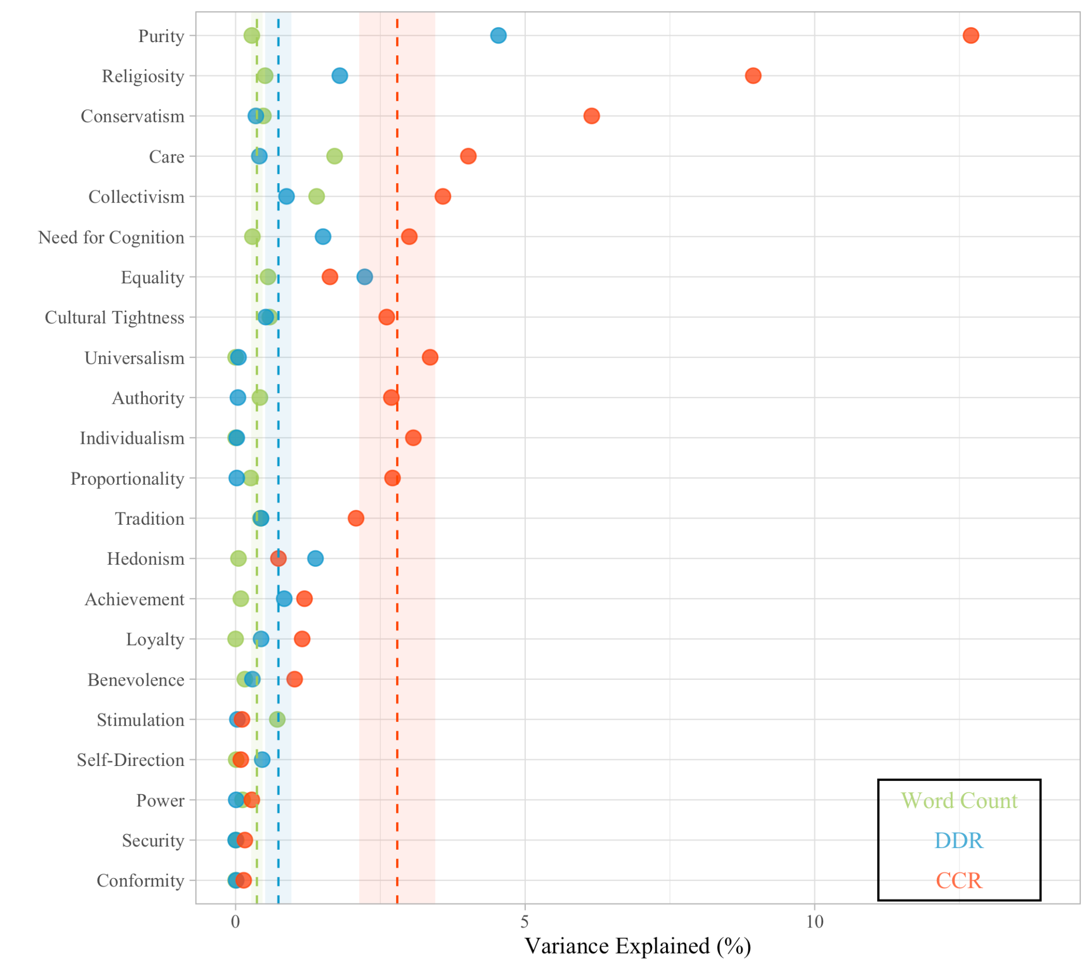
Comparing CCR, DDR (word embeddings), and word counting: Everyday Behavior Essay

Slide 55
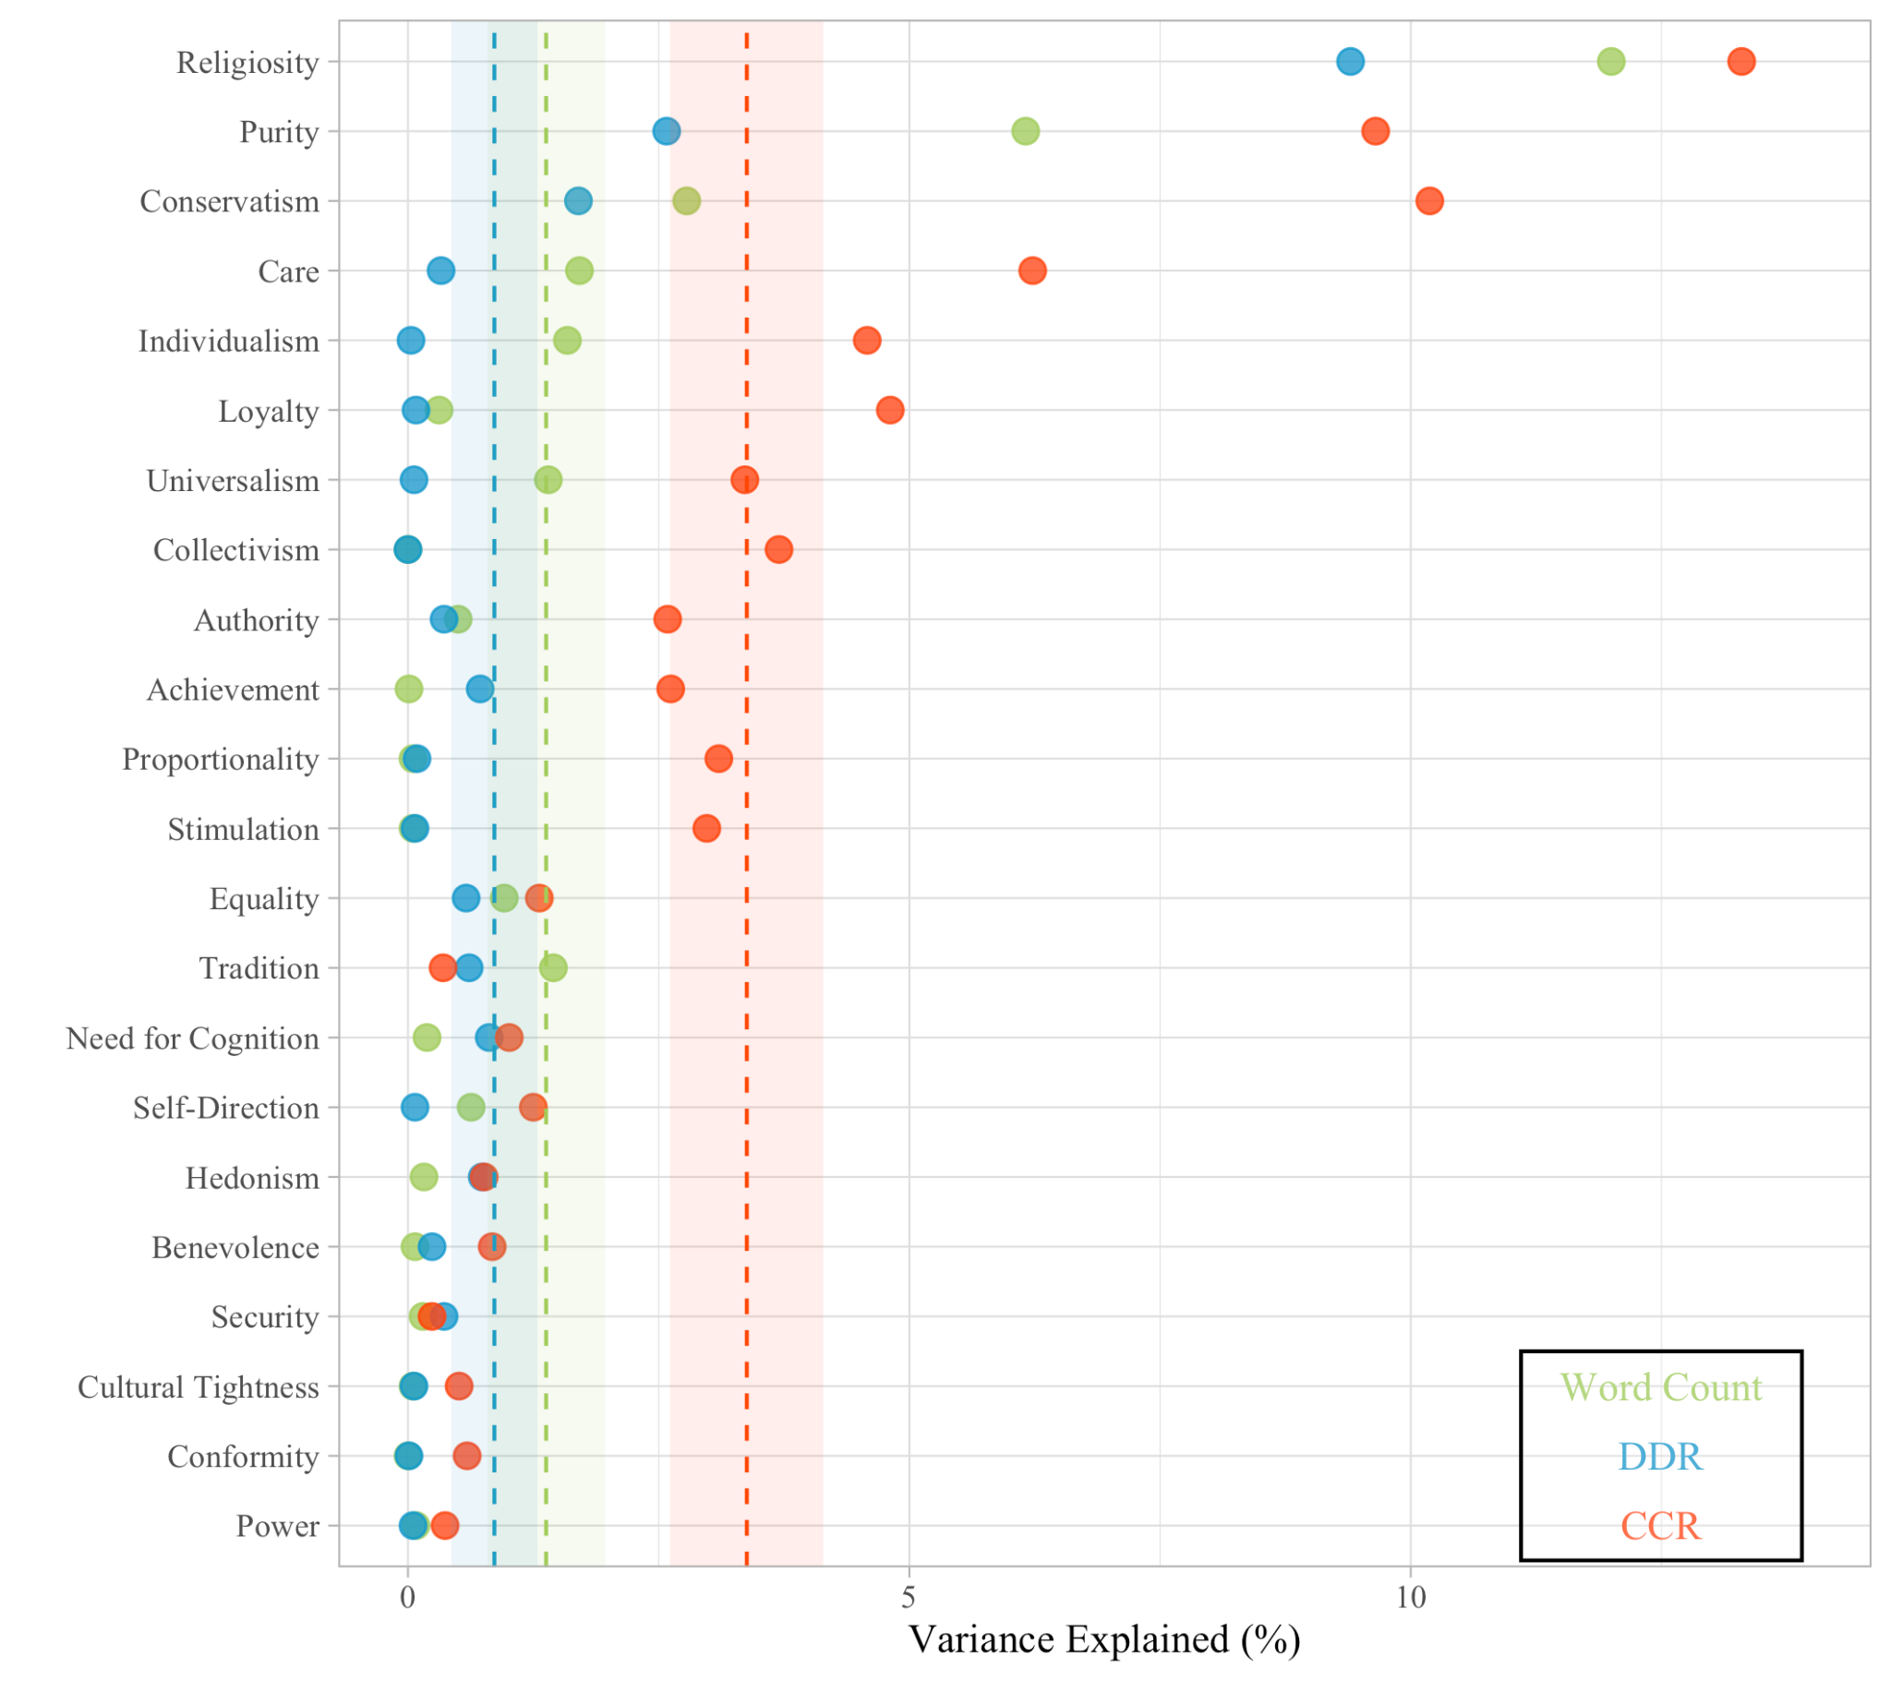
Comparing CCR, DDR (word embeddings), and word counting: Values Essay

Slide 56
Not by words alone…
Words
Surveys
Psychology

Slide 57
Some Conclusions
We actually like ALL THREE METHODS!
Because they are all theory-driven.

Slide 58
Some Conclusions
IF POSSIBLE, Let go of word counting in psychological language analysis
Let’s go back to questionnaires which psychologists actually know how to develop
CCR outperforms word-counting and DDR.
No need to develop word lists (which is painful thing to do, trust me)
CCR works well with complex concepts that cannot be represented using single words
CCR does not obviate the use of some word categories like pronouns (e.g., “I” or “We”, etc.)
As language models become better, so does CCR!

Slide 59
Relevance to Social Psychology
Many attempts to capture complex and context-dependent constructs using dictionaries have failed.
CCR could help.

Slide 60
Relevance to Personality Psychology
If anyone knows how to develop good psychometric scales, it’s you folks (and uhhh… not social psychologists), so enjoy CCR!

Slide 61
Relevance to Cultural Psychology
We have some evidence that CCR works pretty well with cultural orientation (e.g., Individualism, Collectivism) and the strength of norms (e.g., tightness-looseness)
CCR is not dependent on English, and we already have access to language models for over 100 languages. So, the CCR pipeline can be easily applied to more than 100 languages without the pain of translation-back-translation.

Slide 62
Relevance to Historical Psychology
Much of historical psychology has relied on word counting, but we know about semantic shift, and how language use changes across time.
Using CCR in historical corpora can help ameliorate this issue
Also, if you don’t want to use contemporary psychometric scales to measure a historical construct, you can just use a short description or multiple declarative sentences and put them into the CCR pipeline (but this needs to be validated in the future)

Slide 63
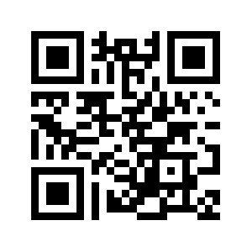

Slide 64
Break!!

Slide 65
Thank you!

